Slide 1

Recap Week 6.
DATA ANALYTICS | IRONHACK

Slide 2

IRONHACK BOOTCAMP
Two ways to get data from the internet:
Pretend to be human
Web scraping
I want this data for my data science project!
Someone has created an API
Ask nicely
APIs
I need to write a request

Slide 3
Web Scraping

Slide 4
IRONHACK BOOTCAMP
BASIC WEB SCRAPING SETUP
import requests
from bs4 import BeautifulSoup
#download the webpage
url = “https://www.the-website-you-wanna-scrape.com”
page = requests.get(url)
# parse the html
soup = BeautifulSoup(page.content, 'html.parser')
# print the formatted html
print(soup.prettify())

Slide 5
IRONHACK BOOTCAMP
HOW TO SEARCH FOR ELEMENTS IN THE SOUP
Using HTML tags:
soup.find_all(“div”, class_=“class-name”)
Using CSS selectors:
soup.select("body div.class-name a")
Practice css selectors

Slide 6
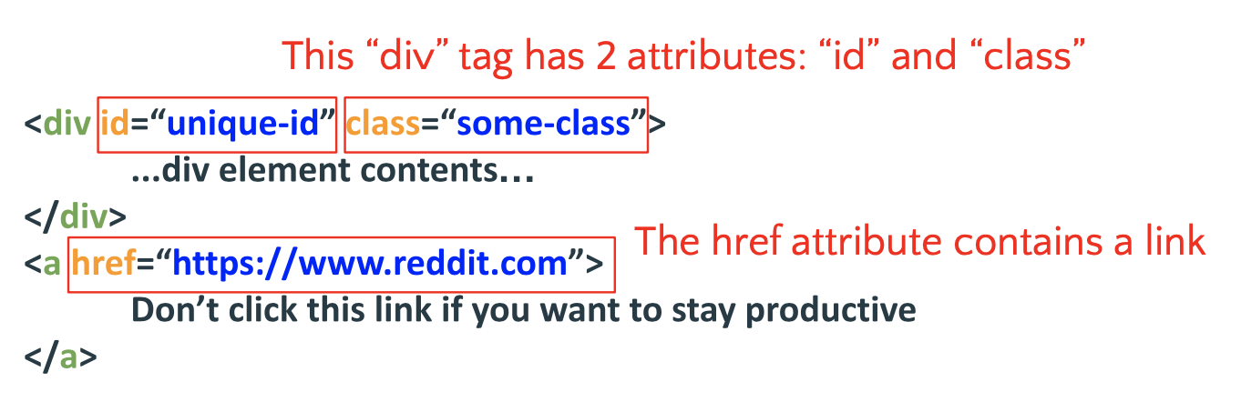
IRONHACK BOOTCAMP
HTML TAGS AND ATTRIBUTES

Slide 7
IRONHACK BOOTCAMP
Browser(e.g. Chrome) INSPECTOR
Chrome inspector is a tool to “see” the html code of any web page.
To use this tool, go to a web page and in any area of it “right click” on it and from the pop up menu select “View web code Ctrl+Upp+I”.
E.g. Inspecting https://www.imdb.com/chart/top

Slide 8
APIs

Slide 9
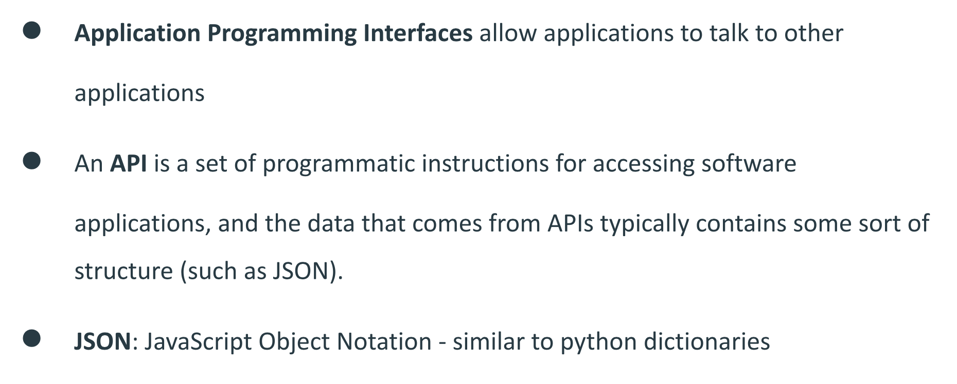
IRONHACK BOOTCAMP
APIS
RESTFUL API

Slide 10
IRONHACK BOOTCAMP
WHY DO WE USE API’S?
The data changes quickly.
You want just a piece of all your data.
Repeated computation involved.
WEB APIs uses Web Standards(HTTP) to facilitate communication between applications.

Slide 11
Spotipy
API Wrapper for Spotify API

Slide 12
IRONHACK BOOTCAMP
Spotipy: How to Use
Official API documentation
Import spotipy
To authenticate
sp = spotipy.Spotify(auth_manager=SpotifyClientCredentials(client_id= Client_ID,client_secret=Client_Secret))
To make searches:
sp.search(q = “user_query”, limit=5 )
Searches can be done by: topic, href, id, uri
If we would like to search for a given playlist, we can use the following function:
sp.user_playlist_tracks("spotify", "playlist_id")
Getting the audio features of a song:
sp.audio_features(song["tracks"]["items"][0]["uri"])[0] (it can accept a list of ids, 100ID max)

Slide 13
Unsupervised Learning
Clustering

Slide 14


Introduction to machine learning
There are three main types of learning:
Supervised: we show to the computers sets of pairs: (example, solution)
Unsupervised: we show the computer how to group and let it work, clustering
Reinforcement learning: learning by doing ( actions, rewards )
How we can teach the computer?
00

Slide 15
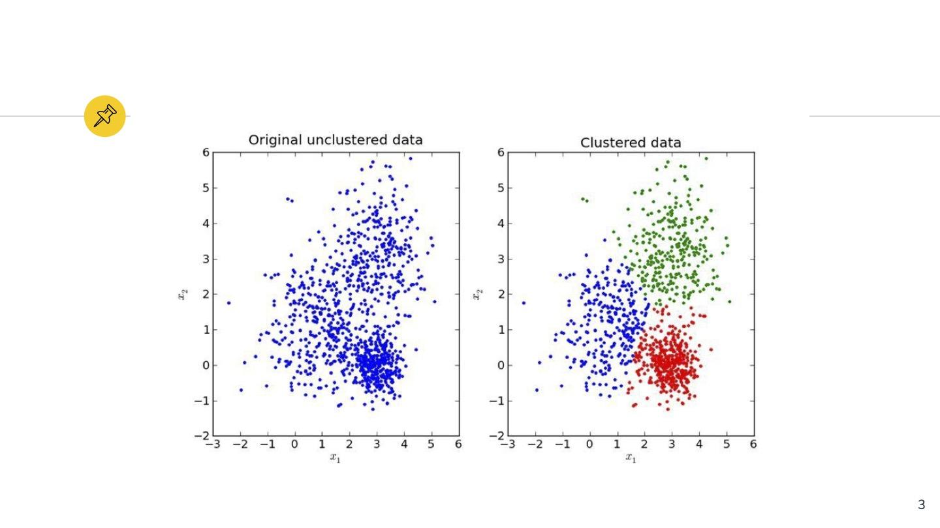
Introduction to machine learning
Clustering is the process of grouping data without telling the computer to which group belongs avery observation.
Clustering

Slide 16
Introduction to machine learning
For K number of groups, pick K random initial locations (centroids)
Calculate the distance to the other points from each centroid.
Assign every observation to the nearest centroid.
Adjust centroids locations to the mean location of every member of the cluster
Repeat until centroid locations doesn’t change significantly (to be defined) (convergence)
K-Means

Slide 17
Introduction to machine learning
What if the initial centroids locations are chosen poorly? (We need to try with several starting positions)
What if the number of groups is chosen poorly?
How do we measure ‘distance’?
K-Means

Slide 18
Sklearn
K-Means is a clustering method which can be found in: sklearn.cluster
from sklearn.cluster import KMeans
K-Means works better when the features had been previously scaled with the StandardScaler() as is sensitive to the scale.
Link1 Link2
As an object, KMeans() works similarly to a transformer, it has two methods fit() and predict():
KMeans().fit(df)
KMeans().predict(new_sc_samples)
Sklearn's KMeans documentation
Scikit-learn KMeans

Slide 19
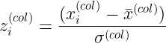
Sklearn
This transformer does the following:
Compute:
mean of every column
standard deviation of every column
For every value of a column, it substracts the column’s mean and divide by the standard deviation of the column.
Scikit-learn StandardScaler()

Slide 20
Transformers need to gather some information from the dataset in order to apply a transformation.
They operate in two steps using the methods fit() and transform():
transformer.fit(df)
transformer.transform(df)
Both steps can be combined in a single method fit_transform():
transformer.fit_transform(df)
They always return a np.array.
If a df is desired, use pd.DataFrame(numpy.array, columns=...)
Sklearn
Scikit-learn transformers

Slide 21
Sklearn
There are three main methods to determine the best K value:
Business restrictions/knowledge
Elbow method
Silhouette method
Scikit-learn KMeans best K?

Slide 22
Sklearn
Your boss demanded a specific number of groups? (money costs talks)
Does it makes sense to have so many or few groups?
What is a reasonable amount of groups?
KMeans best K: business restrictions

Slide 23
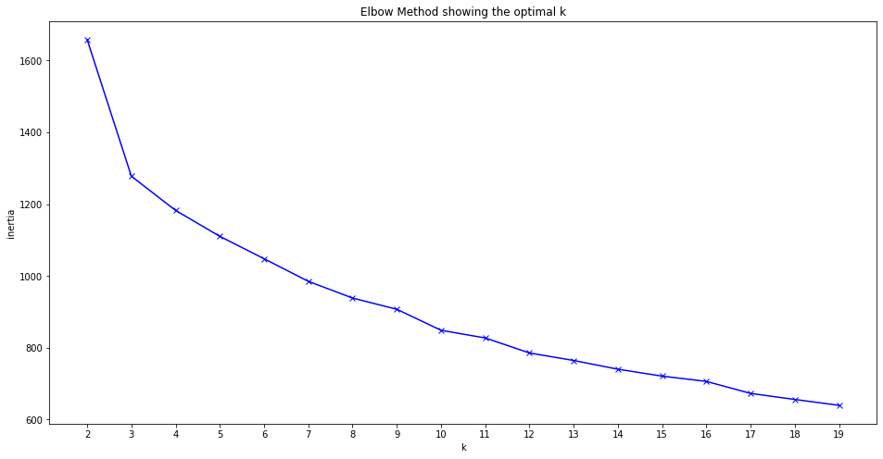
Sklearn
This method computes the average distance between every member of a cluster and the centroid of the cluster to which belongs as a function of the number of clusters.
The best number of clusters is the one for which previous amount doesn’t drop significantly.
KMeans best K: elbow method

Slide 24
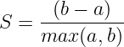
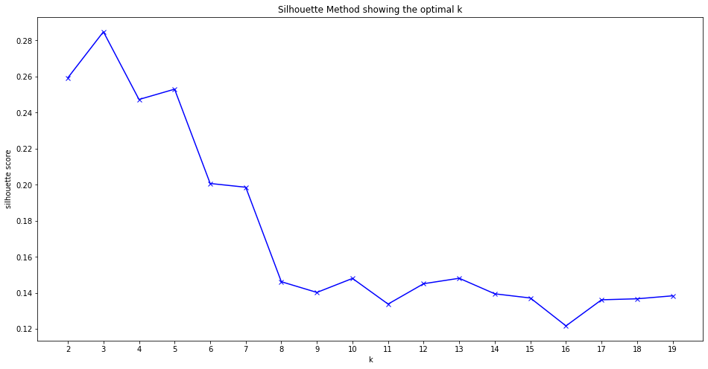
Sklearn
This method computes the “goodness” of the clustering based on:
Mean intracluster distance = a
Mean nearest cluster distance = b
The Silhouette score is given by:
The best number of cluster is selected as the one with the best score.
KMeans best K: silhouette method

Slide 25
Pickle
Serializing Model Objects

Slide 26
Pickle
import pickle
To save the pickle:
def save(amount, filename = “filename.pickle”):
with open(filename, "wb") as f:
pickle.dump(amount, f)
To restore the pickle:
def load(filename = “filename.pickle”):
try:
with open(filename, "rb") as f:
return pickle.load(f)
except FileNotFoundError:
print(“File not found!”)
Pickle: saving and loading objects

Slide 27


